Slide 1
Security in Computing, Fifth Edition
Cryptography

Slide 2
Problems Addressed by Encryption
Consider the steps involved in sending messages from a sender, S, to a recipient, R. If S entrusts the message to T, who then delivers it to R, T then becomes the transmission medium. If an outsider, O, wants to access the message (to read, change, or even destroy it), we call O an interceptor or intruder. Any time after S transmits the message via T, it is vulnerable to exploitation, and O might try to access it in any of the following ways:
• block it, by preventing its reaching R, thereby affecting the availability of the message
• intercept it, by reading or listening to the message, thereby affecting the confidentiality of the message
• modify it, by seizing the message and changing it in some way, affecting the message’s integrity
• fabricate an authentic-looking message, arranging for it to be delivered as if it came from S, thereby also affecting the integrity of the message

Slide 3
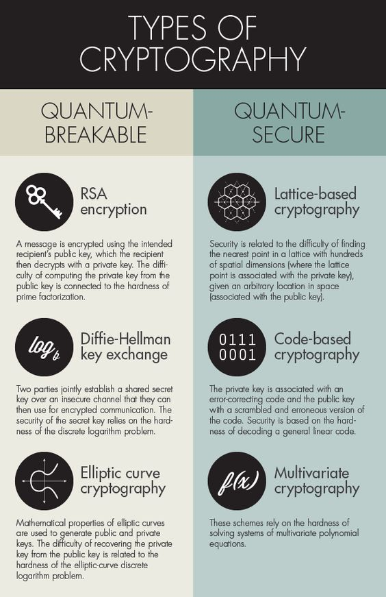
Encryption Terminology
Sender
Recipient
Transmission medium
Interceptor/intruder
Encrypt, encode, or encipher
Decrypt, decode, or decipher
Cryptosystem (A system for encryption and decryption)
Plaintext
Ciphertext

Slide 4
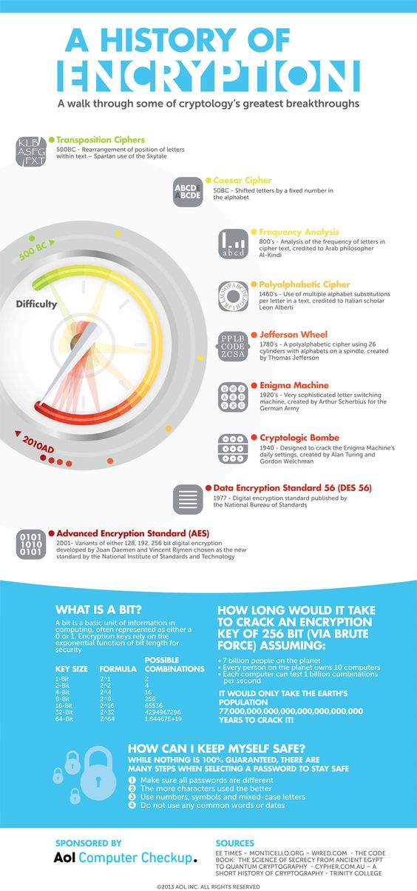
A history of encryption

Slide 5
Encryption/Decryption Process
Notes:
The basic process of encrypting and then decrypting data.

Slide 6
Symmetric vs. Asymmetric Cryptosystem
Symmetric encryption: one key encrypts and decrypts.
Asymmetric encryption: one key encrypts, a different key decrypts.
Notes:
The critical difference between symmetric and asymmetric is that symmetric uses a single key for both encryption and decryption, whereas asymmetric uses complementary keys.

Slide 7
Stream Ciphers
Notes:
In stream ciphers, each byte of the data stream is encrypted separately. This is as opposed to block ciphers, which are shown on the next slide.

Slide 8
Block Ciphers
Stream ciphers encrypt one bit or one byte at a time;
Block ciphers encrypt a fixed number of bits as a single chunk (block of bits).
Notes:
Unlike a stream cipher, a block cipher encrypts a group of plaintext symbols as a single block. The pros and cons of each model are discussed on the next slide.

Slide 9

Diffusion
The idea of diffusion is to hide the relationship between the ciphertext and the plaintext.
In diffusion, the statistical structure of the plaintext is dissipated into long range statistics of the ciphertext.
Each plaintext digit affects the value of many ciphertext digits
Note
Diffusion hides the relationship between the ciphertext and the plaintext.

Slide 10
Confusion
The idea of confusion is to hide the relationship between the ciphertext and the key.
Confusion seeks to make the relationship between the statistics of ciphertext and the value of the encryption key as complex as possible.
Note
Confusion hides the relationship between the ciphertext and the key.

Slide 11
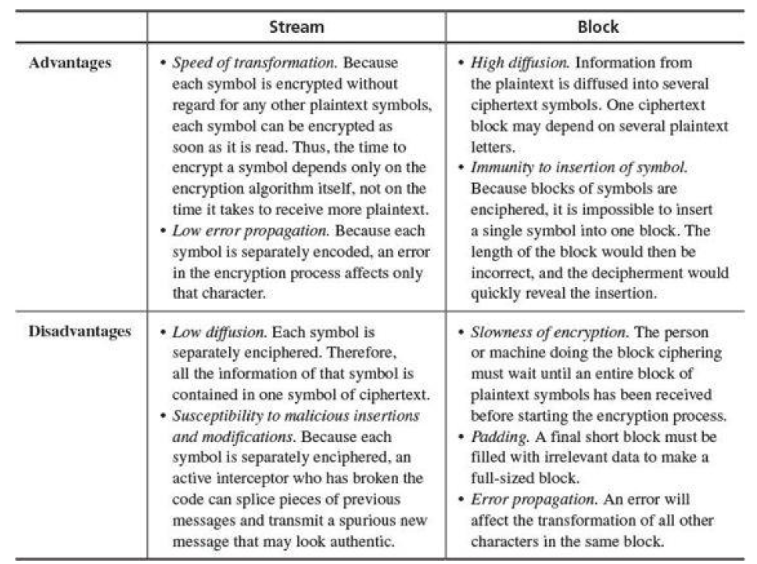

Slide 12
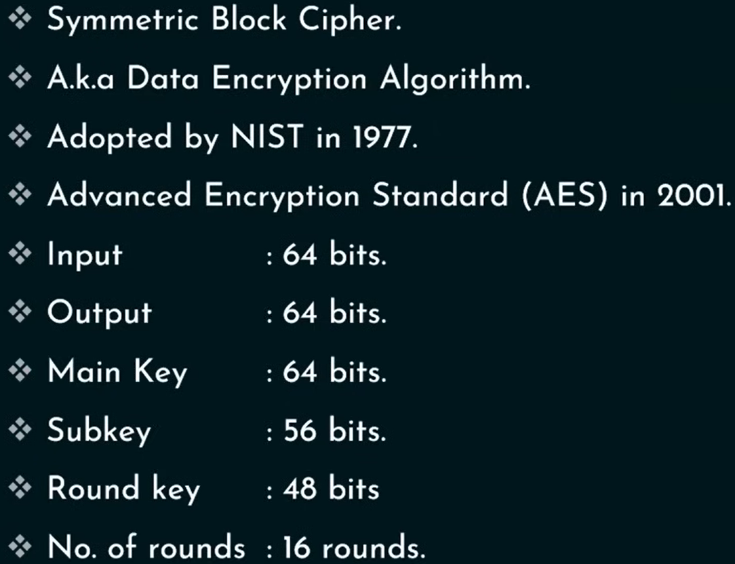
DES: The Data Encryption Standard
Symmetric block cipher
Developed in 1976 by IBM for the US National Institute of Standards and Technology (NIST)

Slide 13
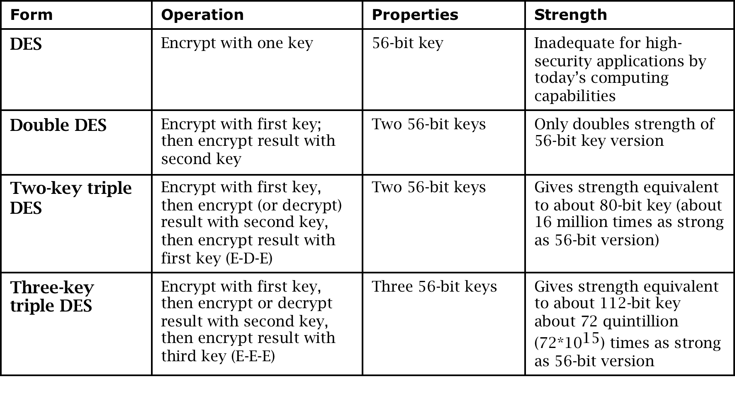
DES: The Data Encryption Standard

Slide 14
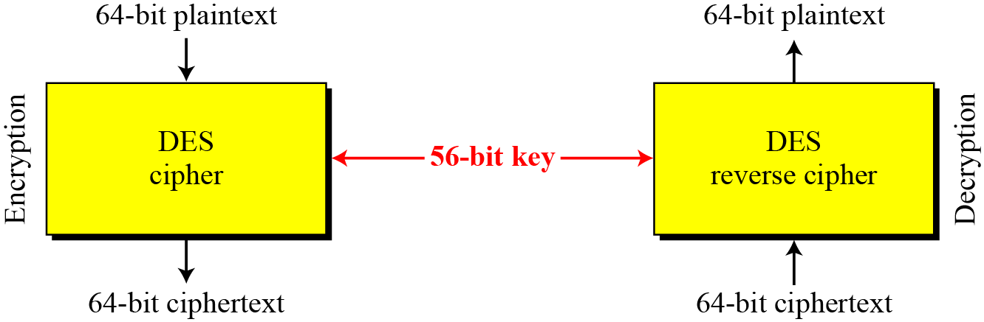
DES is a block cipher, as shown in Figure.
Figure Encryption and decryption with DES

Slide 15
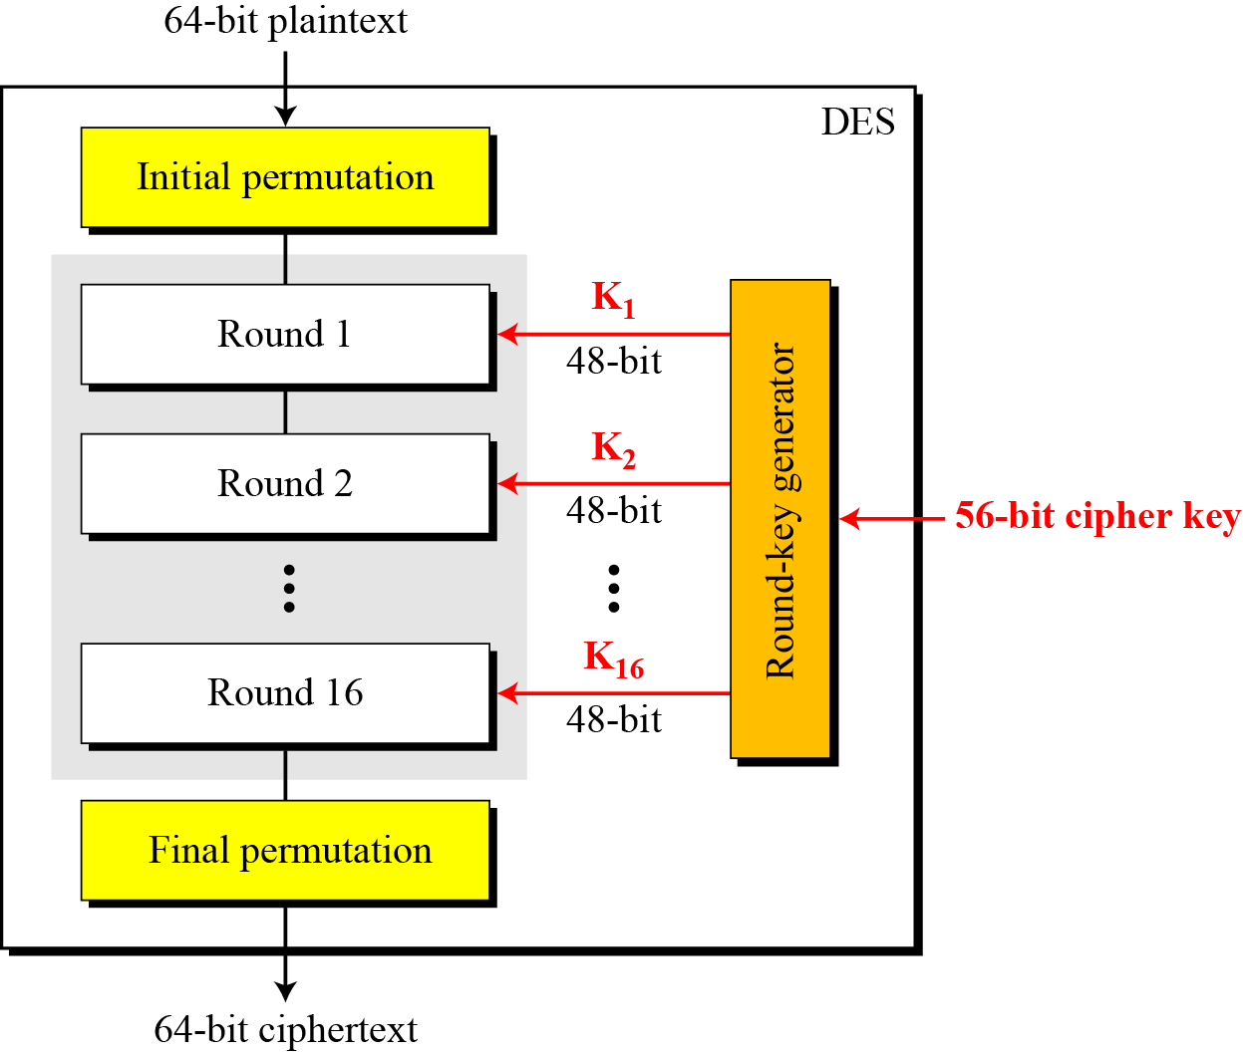
Continue
Figure General structure of DES

Slide 16
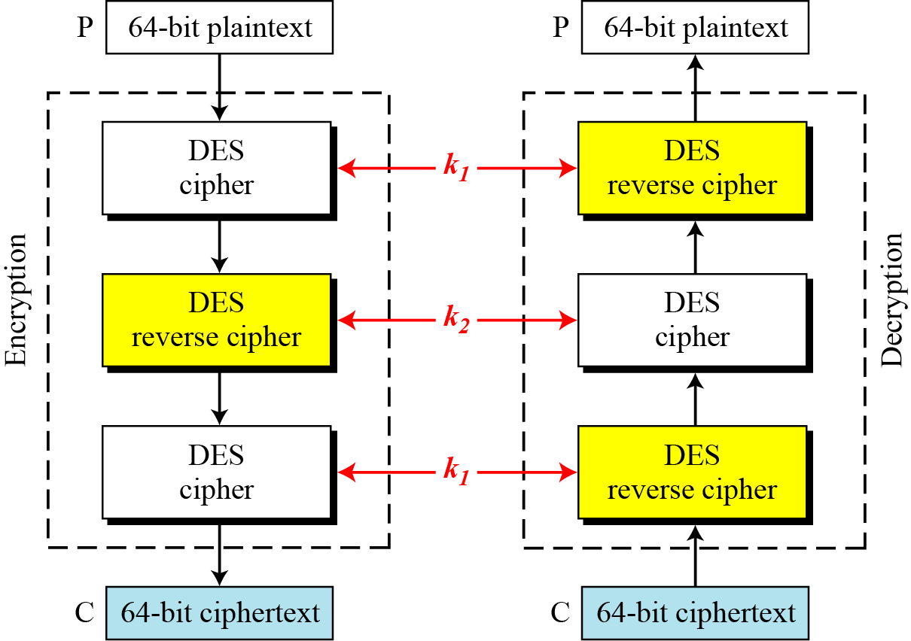
Triple DES
Figure Triple DES with two keys

Slide 17
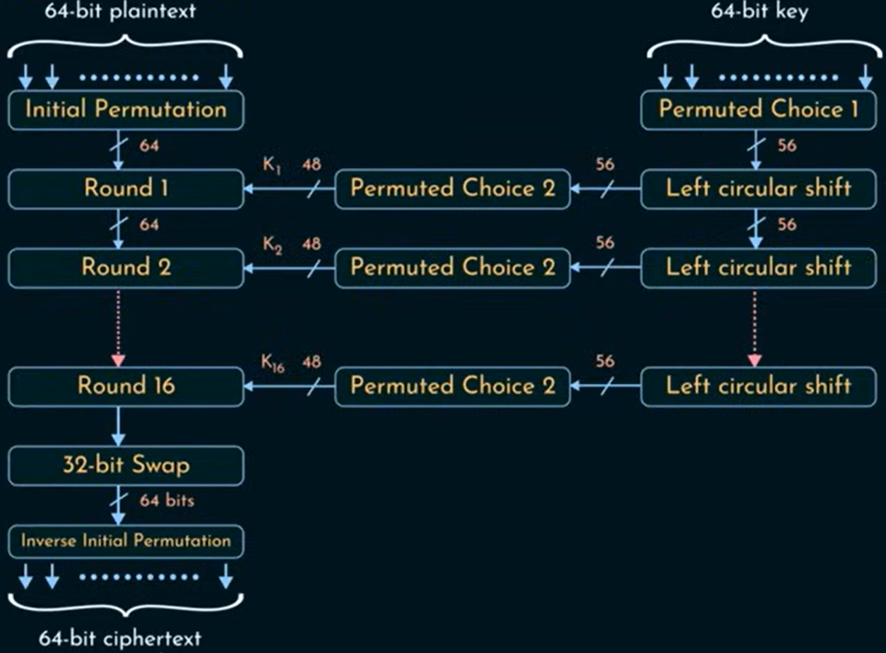
DES

Slide 18

Initial and Final Permutations
Figure Initial permutation in DES

Slide 19
Continue
Table Initial and final permutation tables

Slide 20
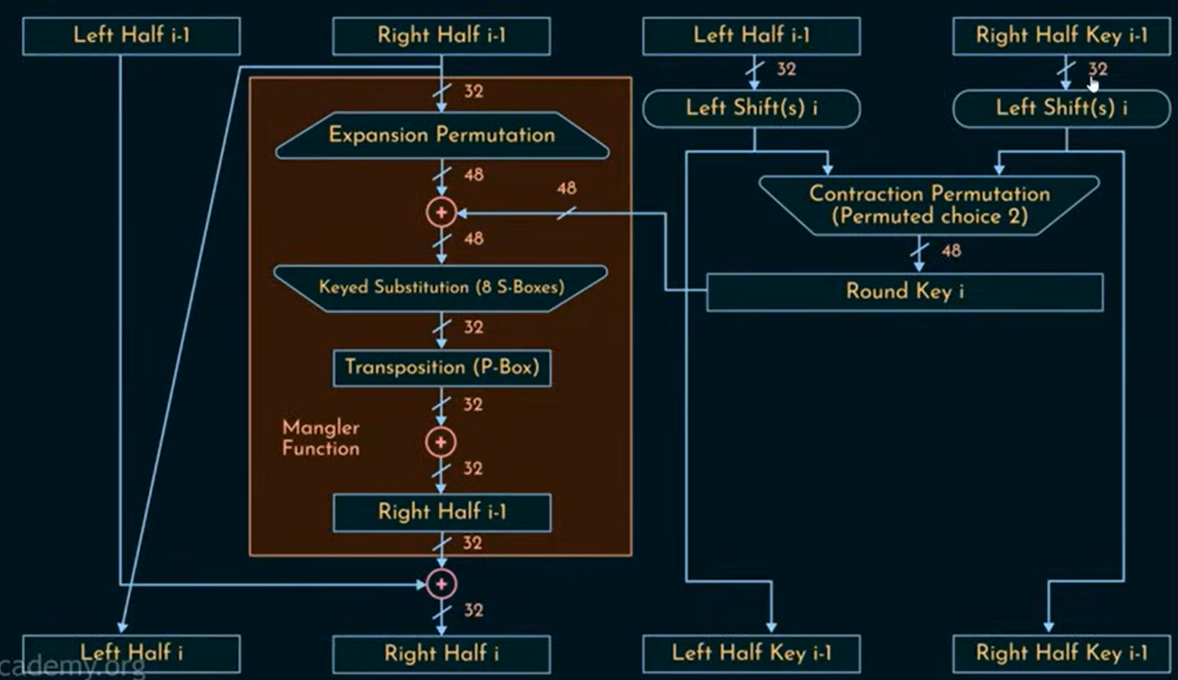
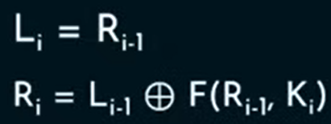
Single Round in DES Algorithm

Slide 21
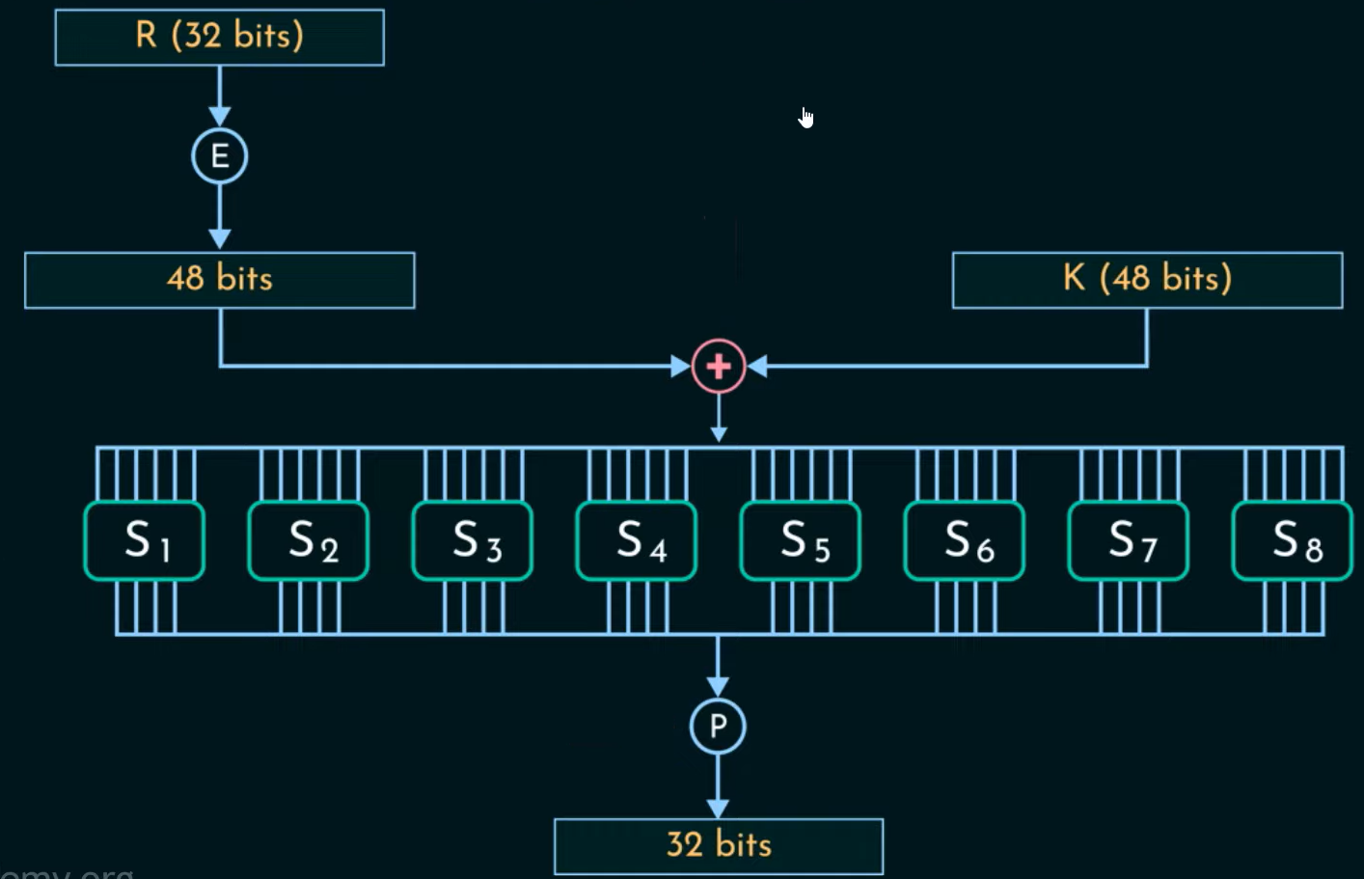
Single Round in DES Algorithm (Mangler Function)

Slide 22
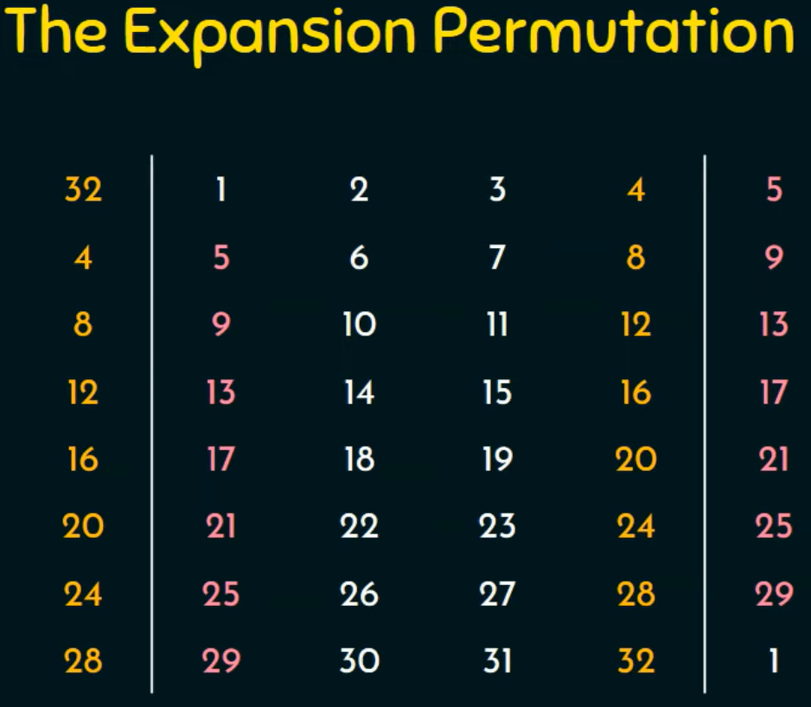
Single Round in DES Algorithm

Slide 23
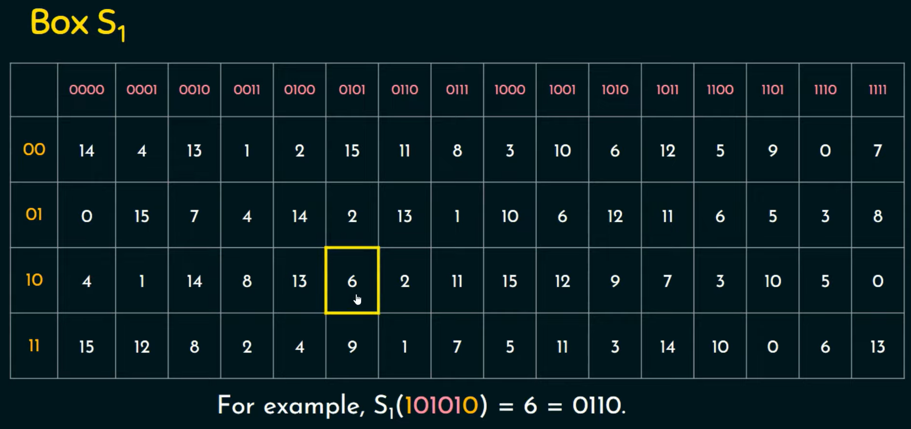
Single Round in DES Algorithm

Slide 24
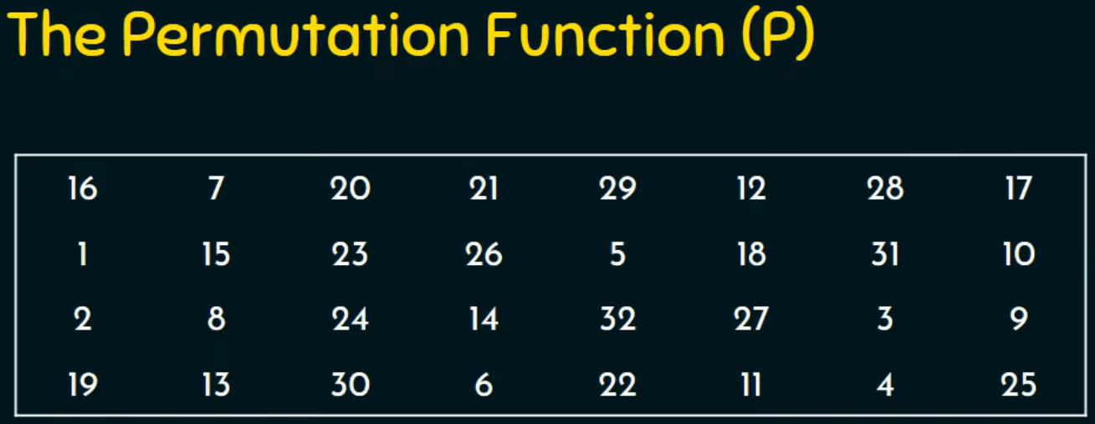
Single Round in DES Algorithm

Slide 25
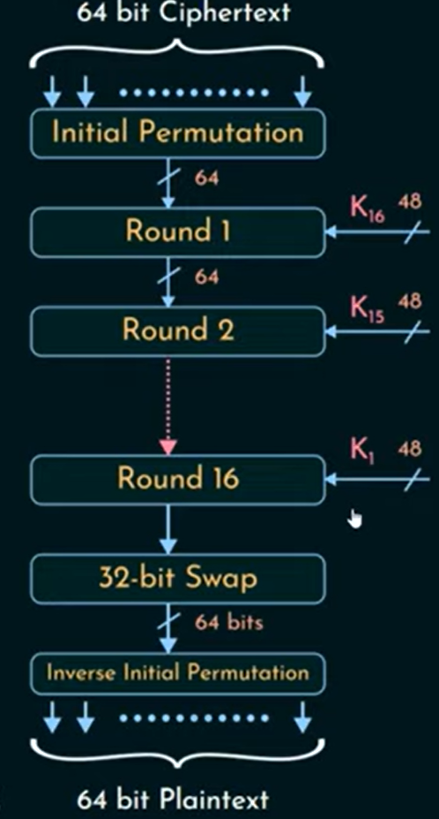
DES Decryption

Slide 26
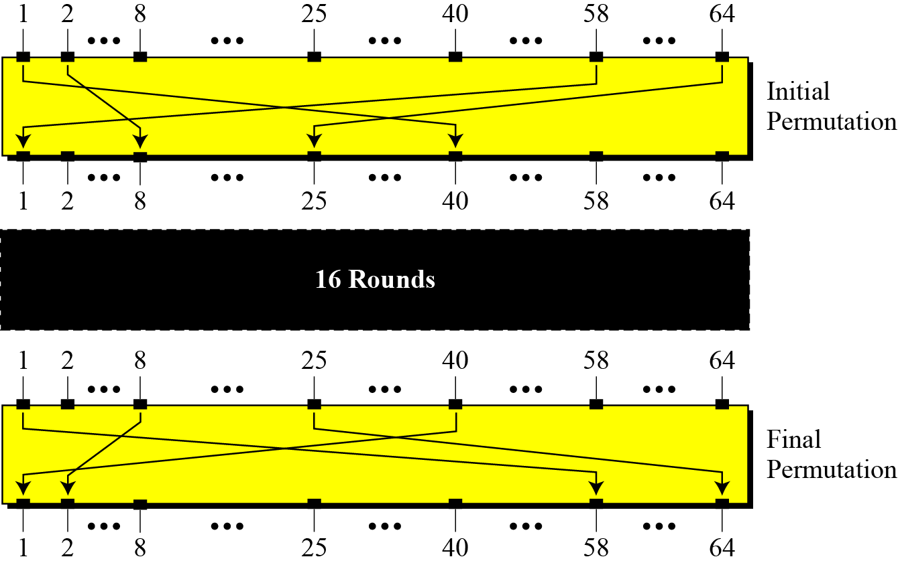
Initial and Final Permutations
Figure Initial and final permutation steps in DES

Slide 27
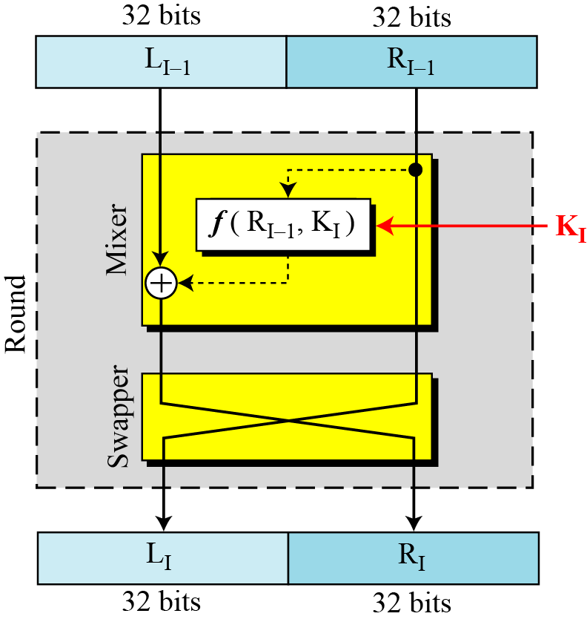
Rounds
DES uses 16 rounds. Each round of DES is a Feistel cipher.
Figure A round in DES (encryption site)

Slide 28
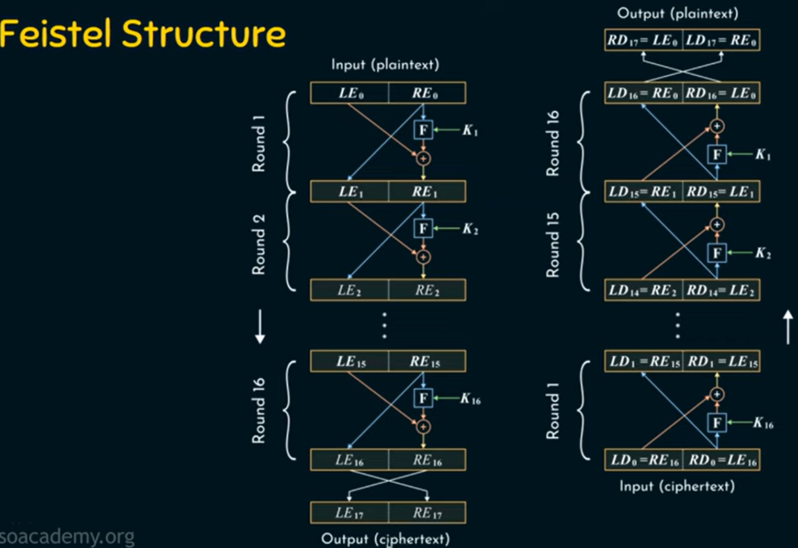
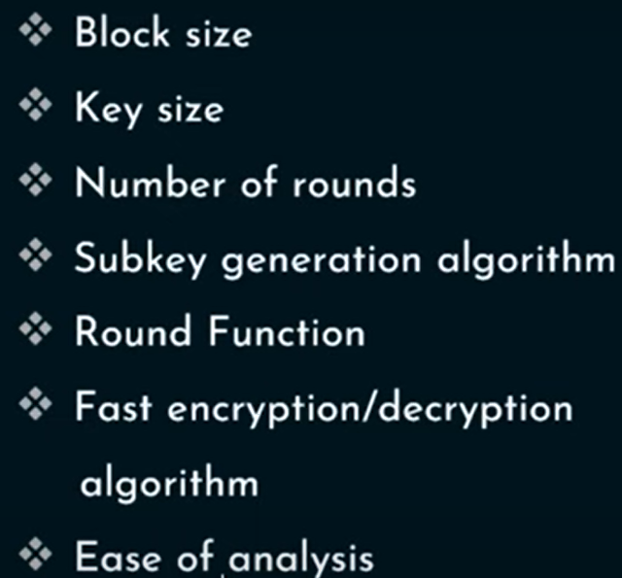

Slide 29
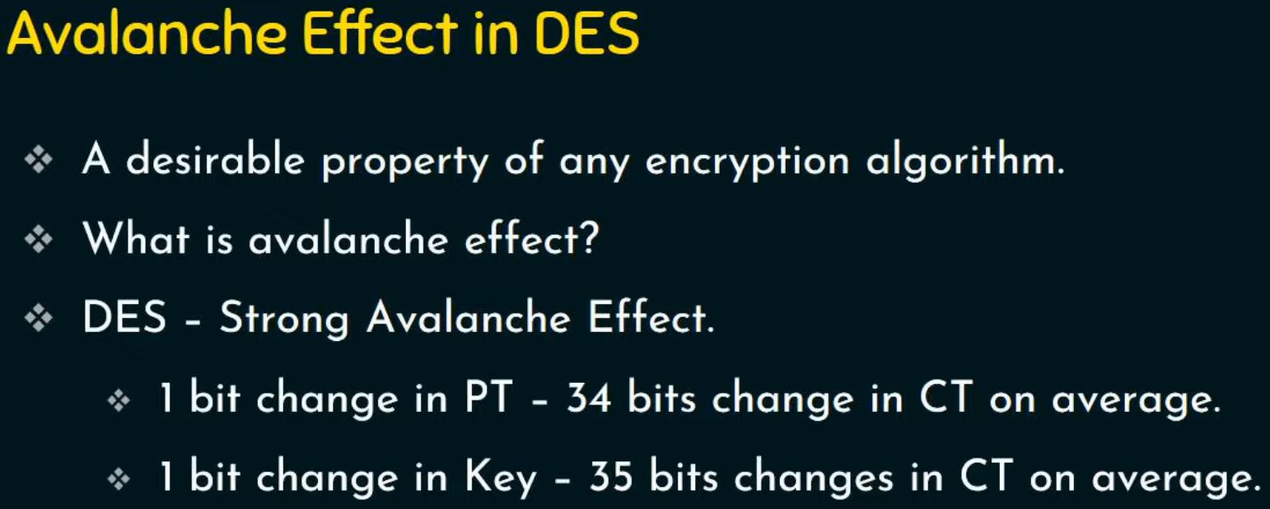

Slide 30
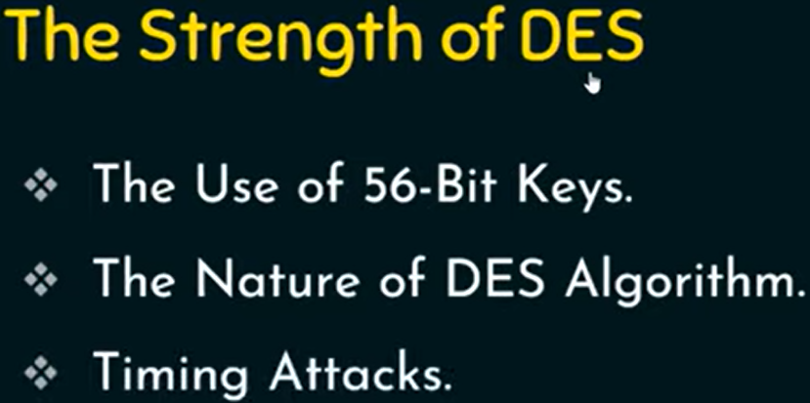

Slide 31
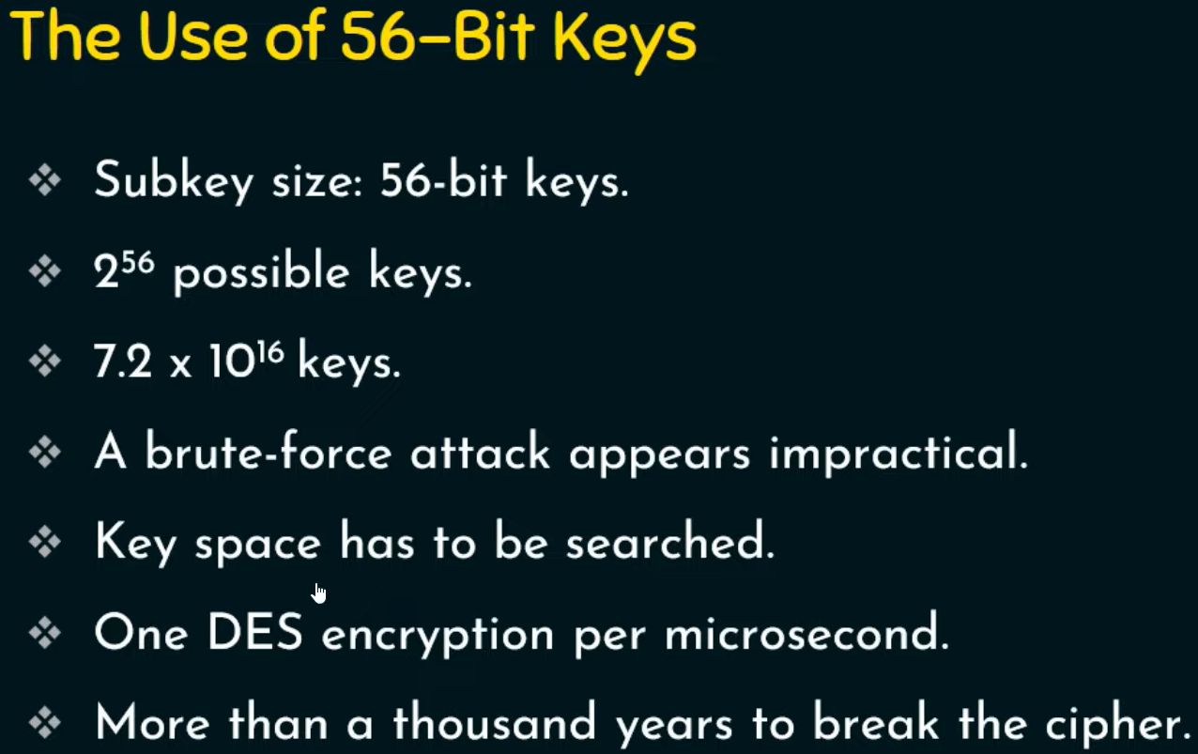
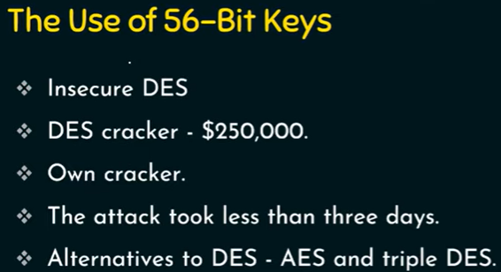

Slide 32
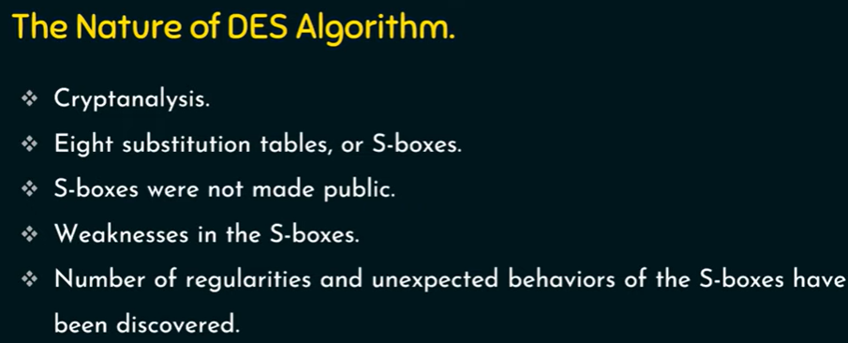

Slide 33
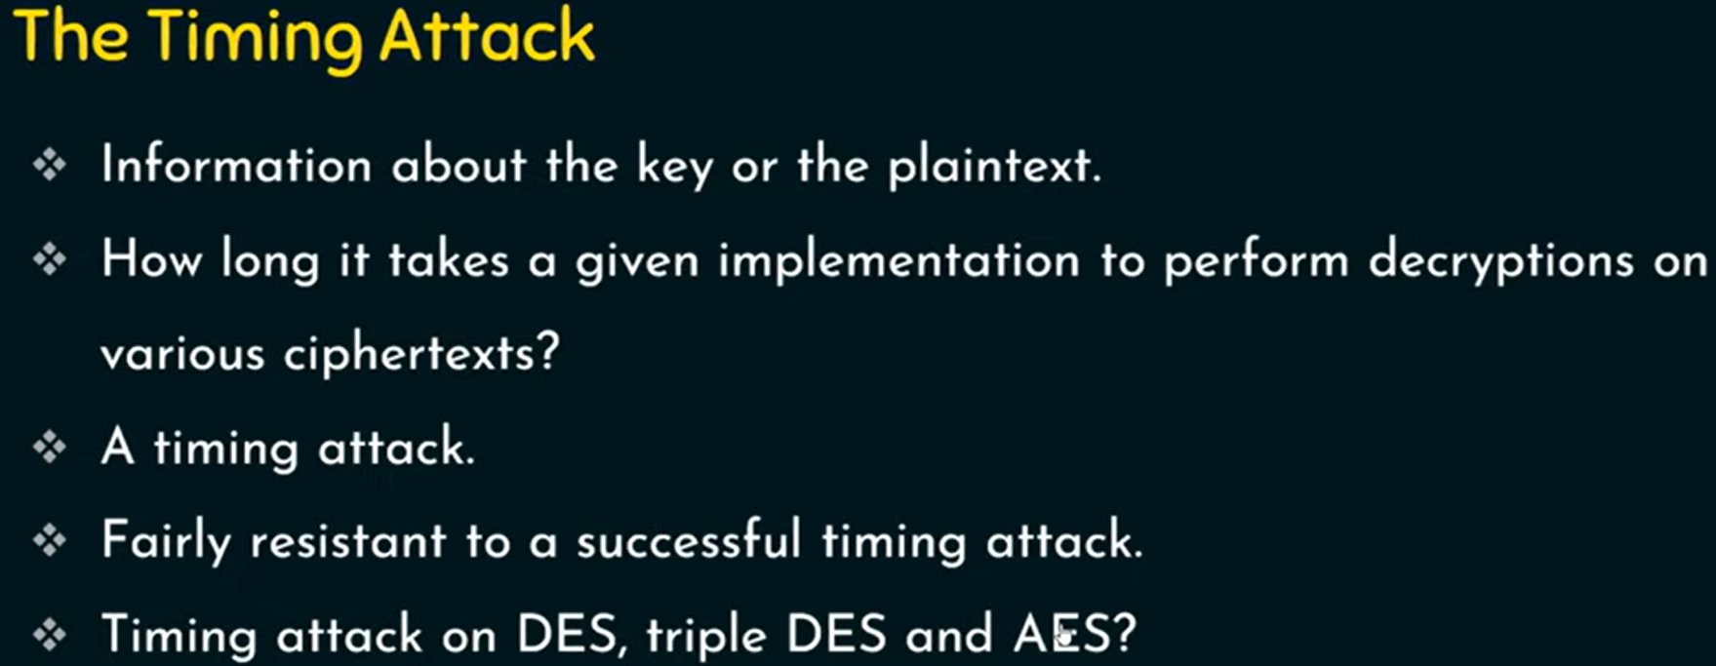

Slide 34
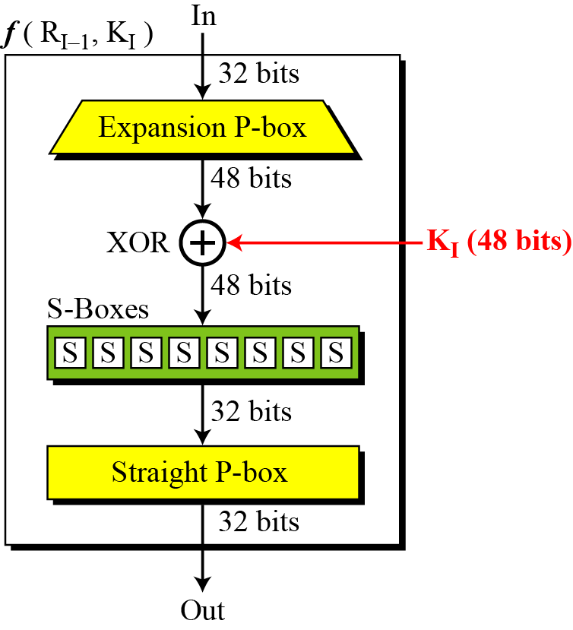
Continued
DES Function
The heart of DES is the DES function. The DES function applies a 48-bit key to the rightmost 32 bits to produce a 32-bit output.
Figure DES function

Slide 35
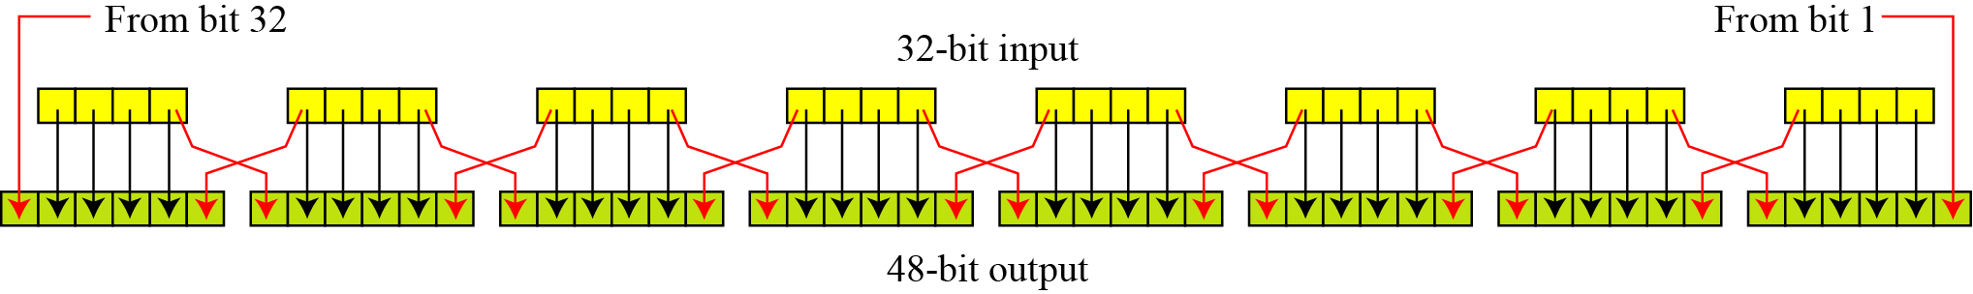
Continue
Expansion P-box
Since R_{I−1} is a 32-bit input and K_{I} is a 48-bit key, we first need to expand R_{I−1} to 48 bits.
Figure Expansion permutation

Slide 36
Continue
Although the relationship between the input and output can be defined mathematically, DES uses Table 6.2 to define this P-box.
Table Expansion P-box table

Slide 37
Continue
Whitener (XOR)
After the expansion permutation, DES uses the XOR operation on the expanded right section and the round key. Note that both the right section and the key are 48-bits in length. Also note that the round key is used only in this operation.

Slide 38
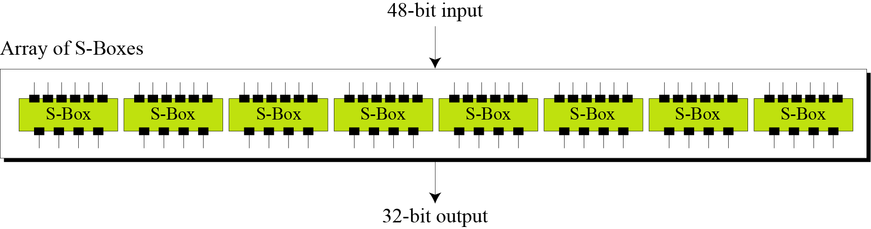
Continue
S-Boxes
The S-boxes do the real mixing (confusion). DES uses 8 S-boxes, each with a 6-bit input and a 4-bit output. See Figure 6.7.
Figure 6.7 S-boxes

Slide 39
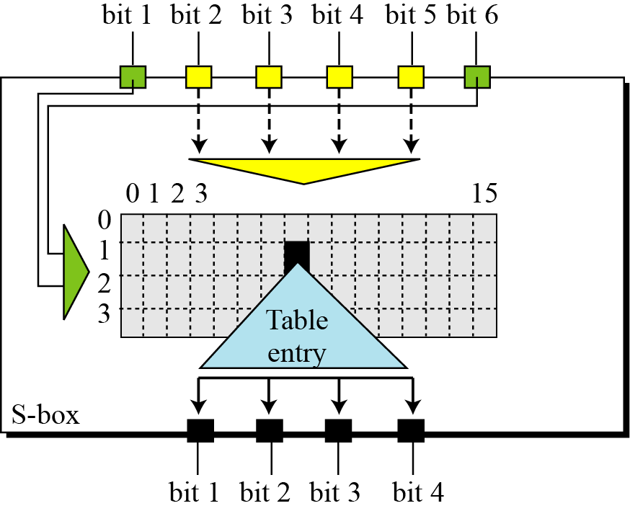
Continue
Figure 6.8 S-box rule

Slide 40
Continue
Table 6.3 shows the permutation for S-box 1. For the rest of the boxes see the textbook.
Table 6.3 S-box 1

Slide 41
Continued
Example 6.3
The input to S-box 1 is 100011. What is the output?
Solution
If we write the first and the sixth bits together, we get 11 in binary, which is 3 in decimal. The remaining bits are 0001 in binary, which is 1 in decimal. We look for the value in row 3, column 1, in Table 6.3 (S-box 1). The result is 12 in decimal, which in binary is 1100. So the input 100011 yields the output 1100.

Slide 42
Continued
Example 6.4
The input to S-box 8 is 000000. What is the output?
Solution
If we write the first and the sixth bits together, we get 00 in binary, which is 0 in decimal. The remaining bits are 0000 in binary, which is 0 in decimal. We look for the value in row 0, column 0, in Table 6.10 (S-box 8). The result is 13 in decimal, which is 1101 in binary. So the input 000000 yields the output 1101.

Slide 43
Continue
Straight Permutation
Table 6.11 Straight permutation table

Slide 44
Cipher and Reverse Cipher
Using mixers and swappers, we can create the cipher and reverse cipher, each having 16 rounds.
First Approach
To achieve this goal, one approach is to make the last round (round 16) different from the others; it has only a mixer and no swapper.
Note
In the first approach, there is no swapper in the last round.

Slide 45
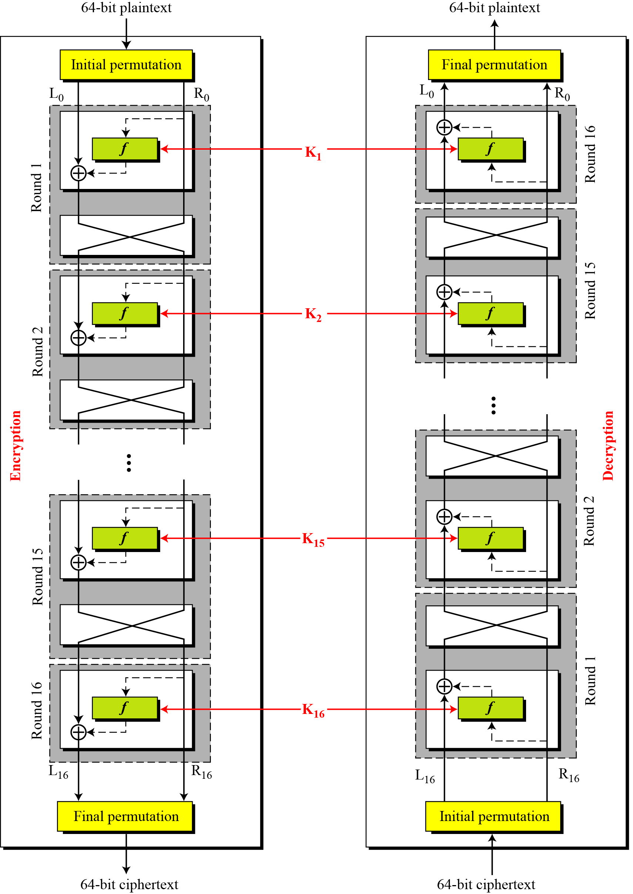
Continued
Figure DES cipher and reverse cipher for the first approach

Slide 46
6.2.3 Continued
Alternative Approach
We can make all 16 rounds the same by including one swapper to the 16th round and add an extra swapper after that (two swappers cancel the effect of each other).
Key Generation
The round-key generator creates sixteen 48-bit keys out of a 56-bit cipher key.

Slide 47
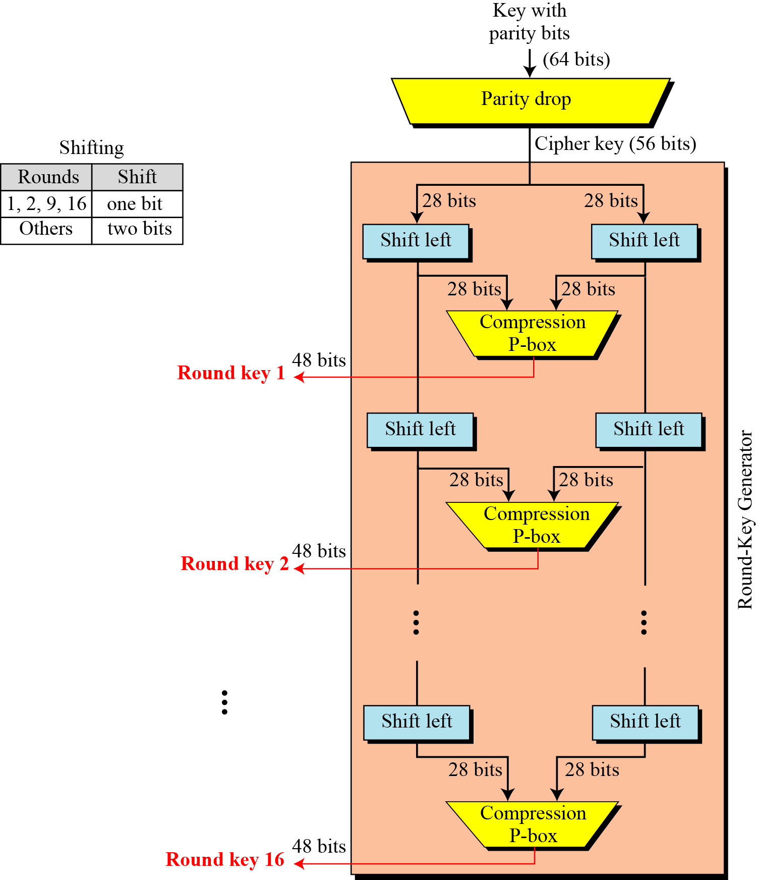
Continued
Figure 6.10 Key generation

Slide 48
Continued
Table 6.12 Parity-bit drop table
Table 6.13 Number of bits shifts

Slide 49
Continued
Table 6.14 Key-compression table

Slide 50
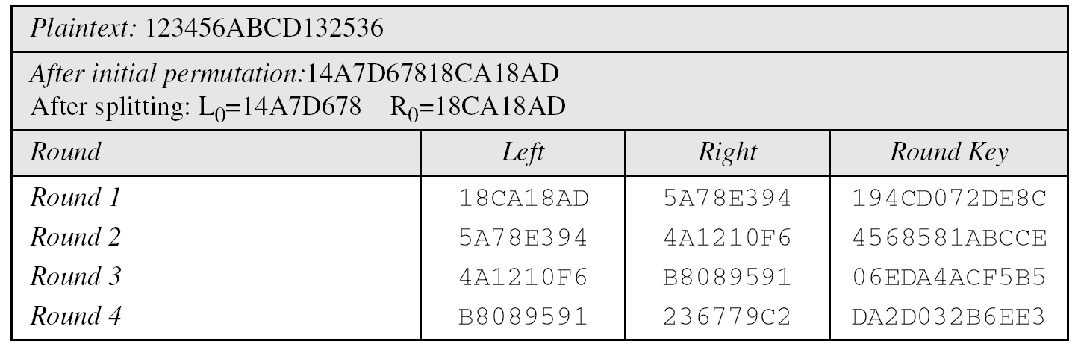
Examples
Example 6.5
We choose a random plaintext block and a random key, and determine what the ciphertext block would be (all in hexadecimal):
Table 6.15 Trace of data for Example 6.5

Slide 51
6.2.4 Continued
Example 6.5
Continued
Table 6.15 Trace of data for Example 6.5 (Conintued

Slide 52
6.2.4 Continued
Example 6.6
Let us see how Bob, at the destination, can decipher the ciphertext received from Alice using the same key. Table 6.16 shows some interesting points.

Slide 53
Strength of DES – Key Size
56-bit keys have 2⁵⁶ = 7.2 x 10¹⁶ values
brute force search looks hard
recent advances have shown is possible
in 1997 on Internet in a few months
in 1998 on dedicated h/w (EFF) in a few days
in 1999 above combined in 22hrs!
now considering alternatives to DES
Notes:
DES finally and definitively proved insecure in July 1998, when the Electronic Frontier Foundation (EFF) announced that it had broken a DES encryption using a special-purpose "DES cracker" machine that was built for less than $250,000. The attack took less than three days. The
EFF has published a detailed description of the machine, enabling others to build their own cracker [EFF98].

Slide 54
Strength of DES – Timing Attacks
A timing attack is one in which information about the key or the plaintext is obtained by observing how long it takes a given implementation to perform decryptions on various ciphertexts.
A timing attack exploits the fact that an encryption or decryption algorithm often takes slightly different amounts of time on different inputs.
attacks actual implementation of cipher
Notes:
AES analysis process has highlighted this attack approach, and is a concern.

Slide 55
Strength of DES – Analytic Attacks
now have several analytic attacks on DES
these utilise some deep structure of the cipher
by gathering information about encryptions
can eventually recover some/all of the sub-key bits
if necessary then exhaustively search for the rest
generally these are statistical attacks
include
differential cryptanalysis
linear cryptanalysis

Slide 56
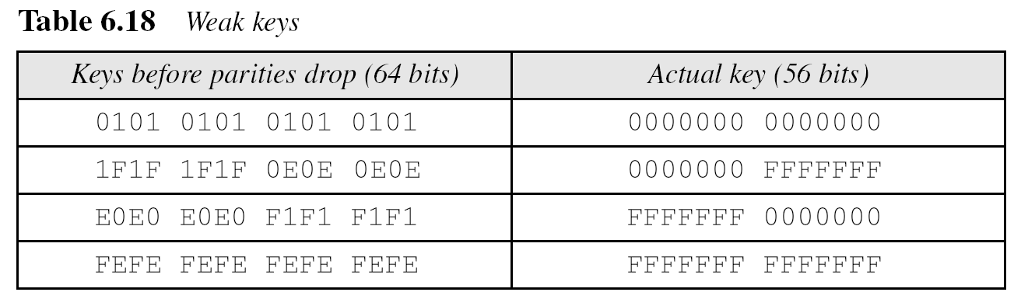
DES Weaknesses
During the last few years critics have found some weaknesses in DES.
Weaknesses in Cipher Design
1. Weaknesses in S-boxes
2. Weaknesses in P-boxes
3. Weaknesses in Key

Slide 57
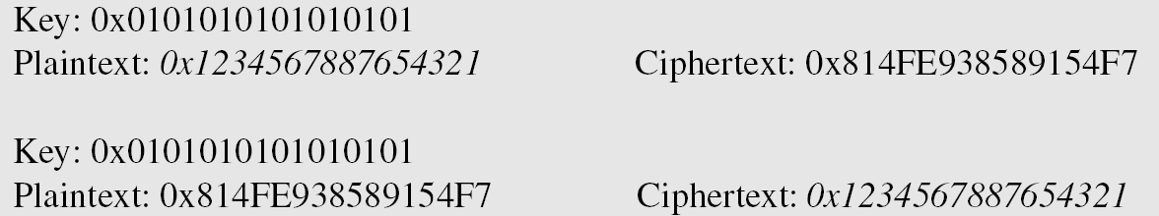
Example 6.8
Let us try the first weak key in Table 6.18 to encrypt a block two times. After two encryptions
with the same key the original plaintext block is created. Note that we have used the encryption algorithm two times, not one encryption followed by another decryption.

Slide 58
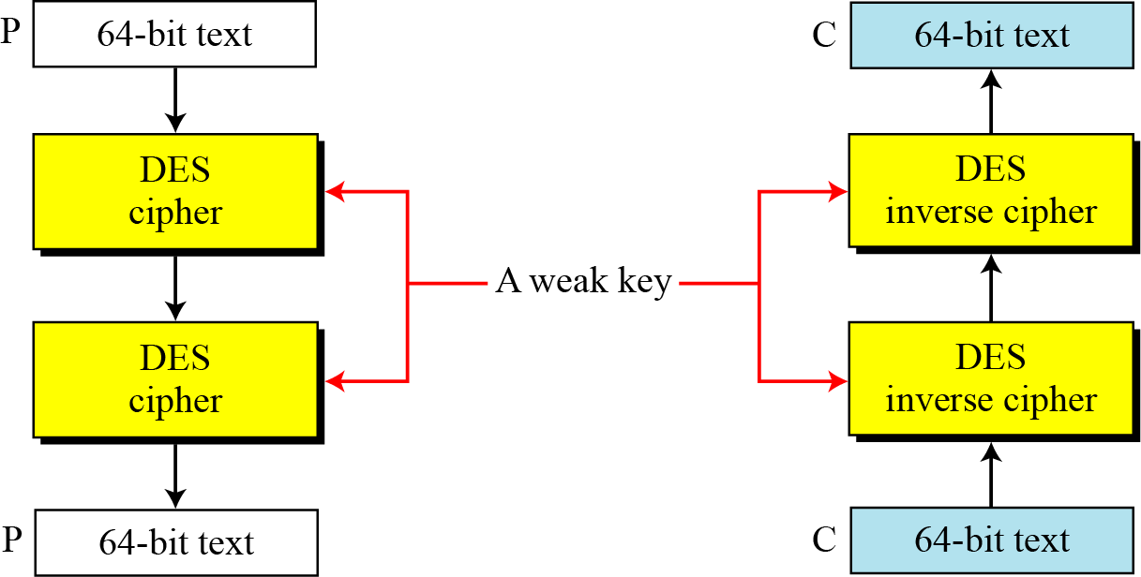
Continued
Figure 6.11 Double encryption and decryption with a weak key

Slide 59
Continued

Slide 60
6.3.3 Continued

Slide 61
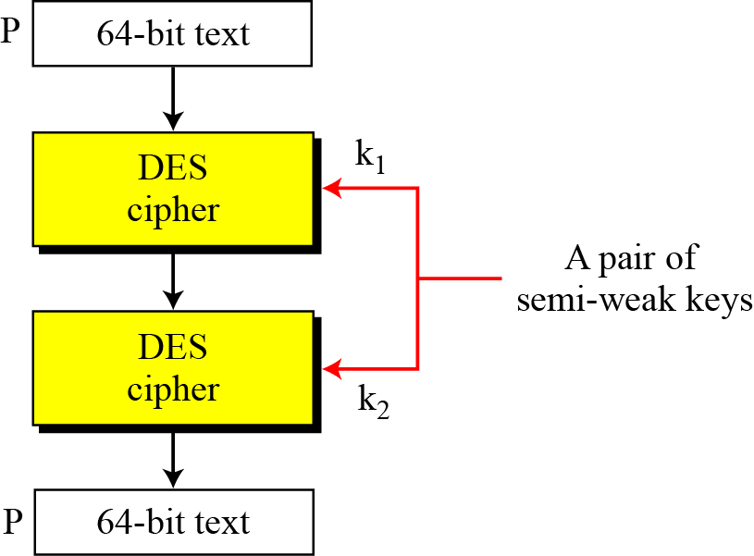
6.3.3 Continued
Figure 6.12 A pair of semi-weak keys in encryption and decryption

Slide 62
6.3.3 Continued
Example 6.9
What is the probability of randomly selecting a weak, a semi-weak, or a possible weak key?
Solution
DES has a key domain of 2⁵⁶. The total number of the above keys are 64 (4 + 12 + 48). The probability of choosing one of these keys is 8.8 × 10⁻¹⁶, almost impossible.

Slide 63
Continued

Slide 64
AES: Advanced Encryption System
There are 10, 12, or 14 cycles for keys of 128, 192, and 256 bits, respectively.
In Rijndael, the cycles are called “rounds.” Each round consists of four steps that substitute and scramble bits.
Bits from the key are frequently combined with intermediate result bits, so key bits are also well diffused throughout the result.
Furthermore, these four steps are extremely fast.

Slide 65
AES: Advanced Encryption System
After a public competition and review, NIST selected an algorithm named Rijndael as the new advanced encryption system; Rijndael is now known more widely as AES.
Overview of AES (Rijndael)
Rijndael is a fast algorithm that can easily be implemented on simple processors.
Although it has a strong mathematical foundation, it primarily uses
substitution,
transposition,
the shift,
exclusive OR, and
addition operations.
Like DES, AES uses repeat cycles.

Slide 66
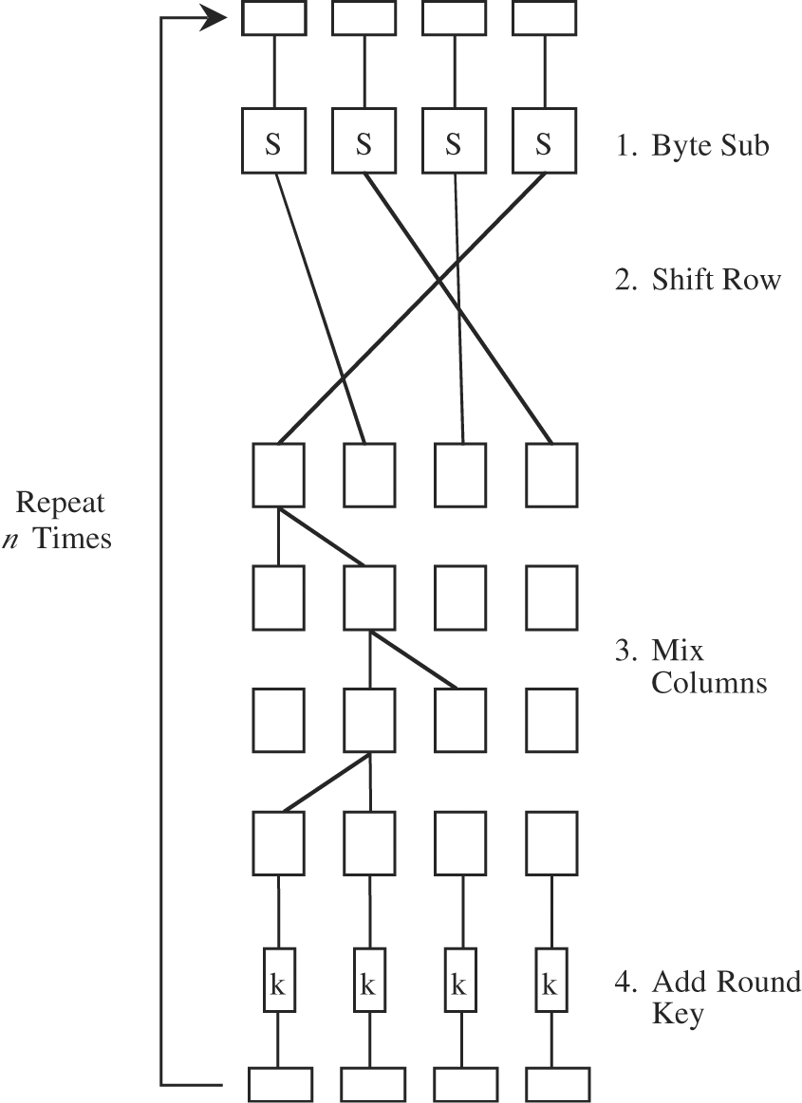
AES: Advanced Encryption System
Symmetric block cipher
Developed in 1999 by independent Dutch cryptographers
Still in common use

Slide 67
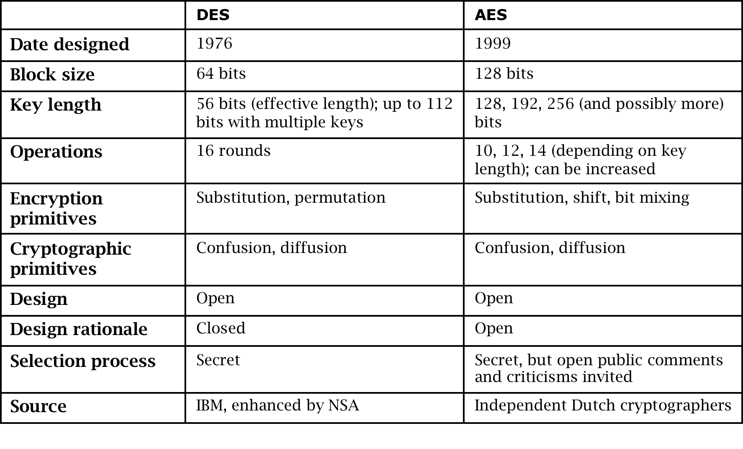
DES vs. AES
Notes:
AES has become the dominant symmetric encryption algorithm in use today. We discuss DES in this book both for historical purposes and because it is a relatively simple algorithm to use to explain how cryptographic primitives work.

Slide 68
Public Key / Asymmetric Cryptography / Rivest–Shamir–Adelman (RSA) Algorithm
Instead of two users sharing one secret key (symmetric key), each user has two keys: one public and one private.
Messages encrypted using the user’s public key and can only be decrypted using the user’s private key, and vice versa.

Slide 69
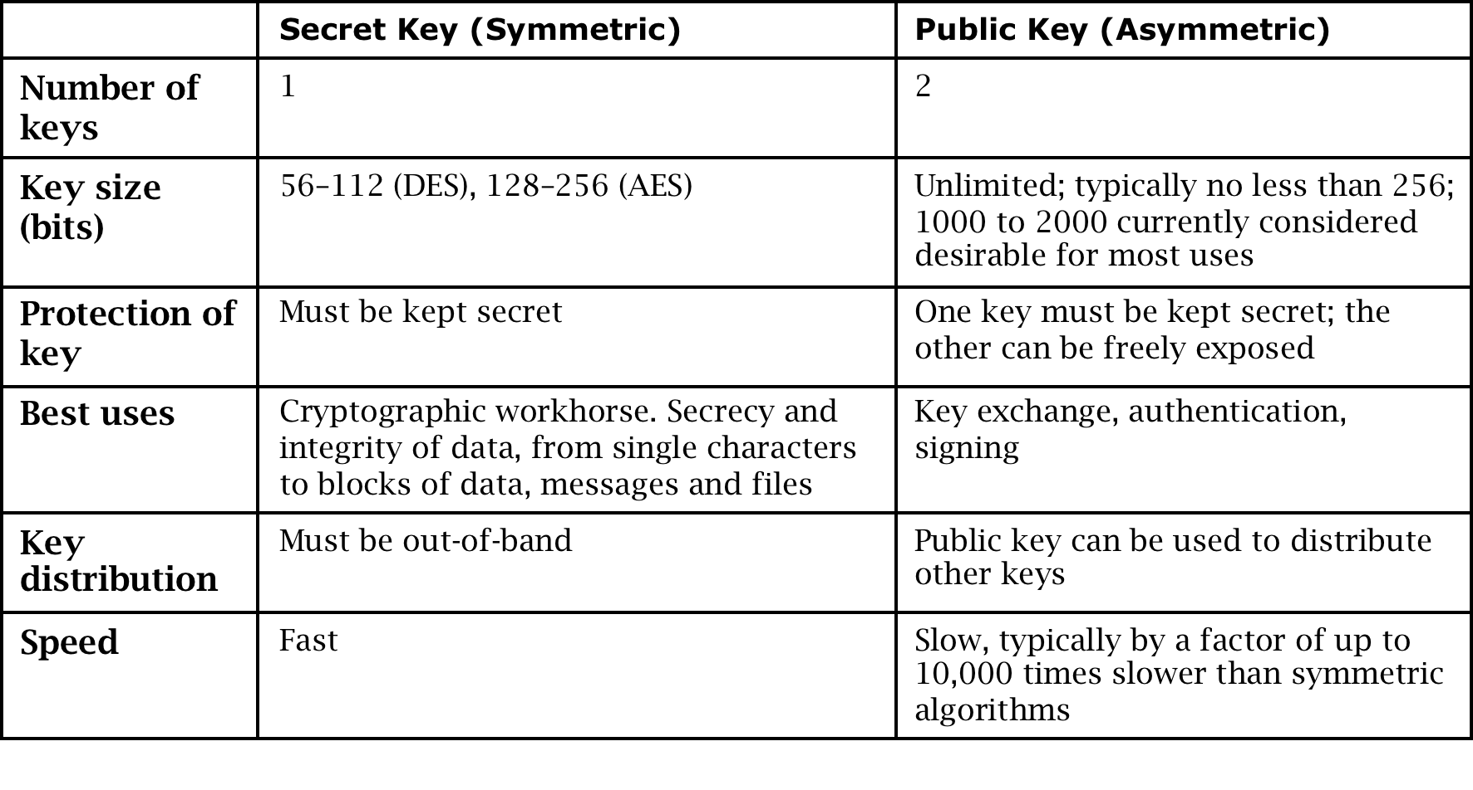
Secret Key vs. Public Key Encryption
Notes:
Symmetric and asymmetric algorithms have complementary strengths and weaknesses and are therefore used both for different purposes and in concert with each other.

Slide 70
Public-Key Cryptography
probably most significant advance in the 3000 year history of cryptography
uses two keys – a public & a private key
asymmetric since parties are not equal
uses clever application of number theoretic concepts to function
Notes:
Will now discuss the radically different public key systems, in which two keys are used. Anyone knowing the public key can encrypt messages or verify signatures, but cannot decrypt messages or create signatures, counter-intuitive though this may seem. It works by the clever use of number theory problems that are easy one way but hard the other. Note that public key schemes are neither more secure than private key (security depends on the key size for both), nor do they replace private key schemes (they are too slow to do so), rather they complement them.

Slide 71
Public-Key Cryptography
public-key/two-key/asymmetric cryptography involves the use of two keys:
a public-key, which may be known by anybody, and can be used to encrypt messages, and verify signatures
a private-key, known only to the recipient, used to decrypt messages, and sign (create) signatures
is asymmetric because
those who encrypt messages or verify signatures cannot decrypt messages or create signatures

Slide 72
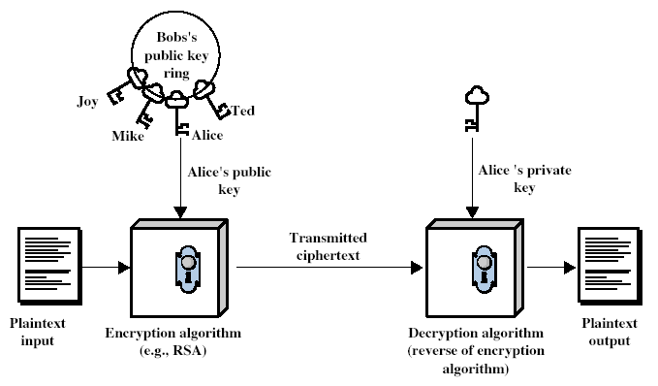
Public-Key Cryptography
Notes:
Stallings Fig 9.1

Slide 73
Why Public-Key Cryptography?
Developed to address two key issues:
key distribution – how to have secure communications in general without having to trust a KDC with your key
digital signatures – how to verify a message comes intact from the claimed sender
public invention due to Whitfield Diffie & Martin Hellman at Stanford Uni in 1976
known earlier in classified community
Notes:
The idea of public key schemes, and the first practical scheme, which was for key distribution only, was published in 1977 by Diffie & Hellman. The concept had been previously described in a classified report in 1970 by James Ellis (UK CESG) - and subsequently declassified in 1987. See History of Non-secret Encryption (at CESG). Its interesting to note that they discovered RSA first, then Diffie-Hellman, opposite to the order of public discovery!

Slide 74
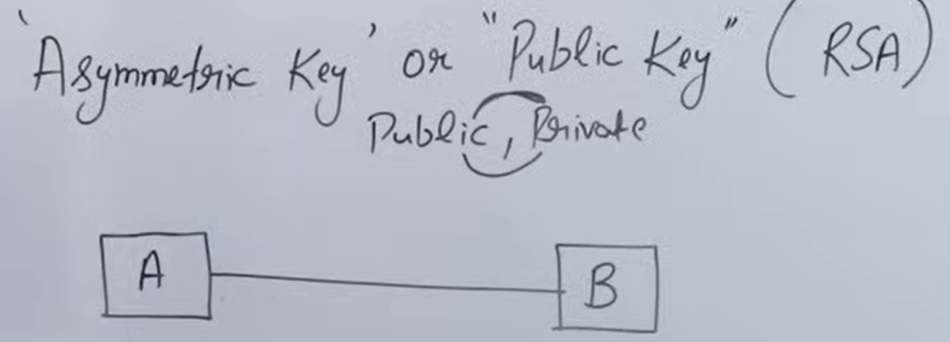
Public-Key Cryptography (The Rivest–Shamir–Adelman (RSA) Algorithm)
Case1- E [Pub-A [Message]]
Case2- E [Priv-B [Message]]
Case3- E [Priv-A [Message]]
Case4- E [Pub-B [Message]]
Pub-A Pub-B
Priv-A Priv-B
Notes:
The idea of public key schemes, and the first practical scheme, which was for key distribution only, was published in 1977 by Diffie & Hellman. The concept had been previously described in a classified report in 1970 by James Ellis (UK CESG) - and subsequently declassified in 1987. See History of Non-secret Encryption (at CESG). Its interesting to note that they discovered RSA first, then Diffie-Hellman, opposite to the order of public discovery!

Slide 75
Public-Key Characteristics
Public-Key algorithms rely on two keys with the characteristics that it is:
computationally infeasible to find decryption key knowing only algorithm & encryption key
computationally easy to en/decrypt messages when the relevant (en/decrypt) key is known
either of the two related keys can be used for encryption, with the other used for decryption (in some schemes)
Notes:
Public key schemes utilise problems that are easy (P type) one way but hard (NP type) the other way, eg exponentiation vs logs, multiplication vs factoring. Consider the following analogy using padlocked boxes: traditional schemes involve the sender putting a message in a box and locking it, sending that to the receiver, and somehow securely also sending them the key to unlock the box. The radical advance in public key schemes was to turn this around, the receiver sends an unlocked box to the sender, who puts the message in the box and locks it (easy - and having locked it cannot get at the message), and sends the locked box to the receiver who can unlock it (also easy), having the key. An attacker would have to pick the lock on the box (hard).

Slide 76
Public-Key Applications
can classify uses into 3 categories:
encryption/decryption (provide secrecy) The sender encrypts a message with the recipient's public key.
digital signatures (provide authentication) The sender "signs" a message with its private key. Signing is achieved by a cryptographic algorithm applied to the message or to a small block of data that is a function of the message.
key exchange (of session keys) Two sides cooperate to exchange a session key. Several different approaches are possible, involving the private key(s) of one or both parties.
some algorithms are suitable for all uses, others are specific to one

Slide 77
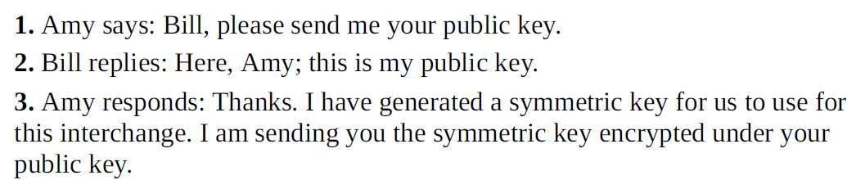
Public Key to Exchange Secret (symmetric) Keys
Notes:
This is a great example of asymmetric and symmetric encryption being used together. We need asymmetric to perform the initial exchange securely, but thereafter we can benefit from the speed of a symmetric algorithm.

Slide 78
Key Exchange Man-in-the-Middle
Notes:
This exchange is the same as on the previous slide, but with an attacker in the middle. This attack can be defeated using the simple tweak described on pp. 107–108 of the textbook. This is an interesting problem to have students brainstorm or work on for homework.

Slide 79
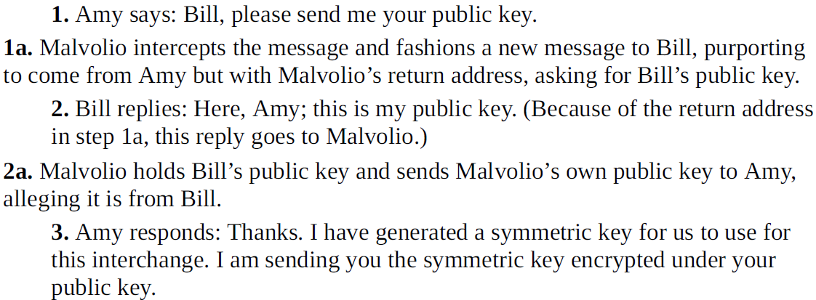
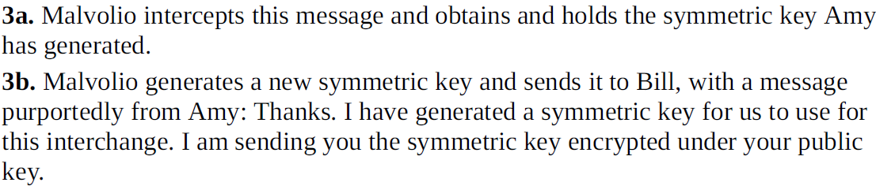
Key Exchange Man in the Middle
Notes:
This exchange is the same as on the previous slide, but with an attacker in the middle. This attack can be defeated using the simple tweak described on pp. 107–108 of the textbook. This is an interesting problem to have students brainstorm or work on for homework.

Slide 80
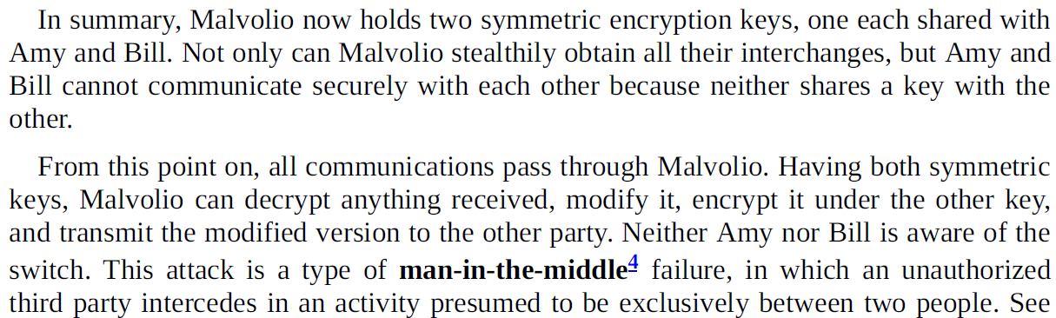
Key Exchange Man in the Middle
Notes:
This exchange is the same as on the previous slide, but with an attacker in the middle. This attack can be defeated using the simple tweak described on pp. 107–108 of the textbook. This is an interesting problem to have students brainstorm or work on for homework.

Slide 81
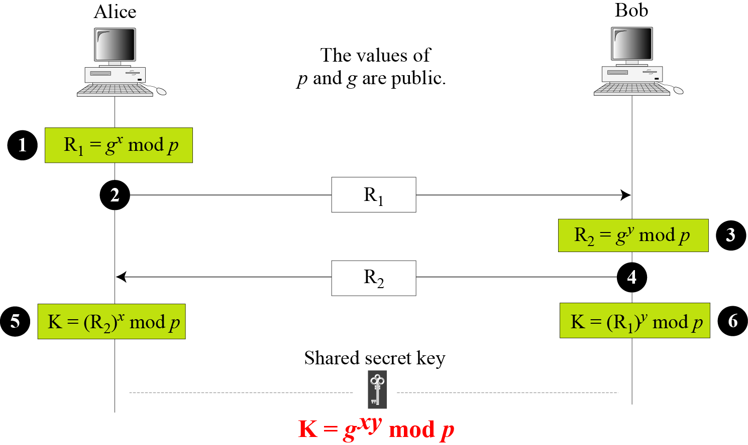
Diffie-Hellman method

Slide 82
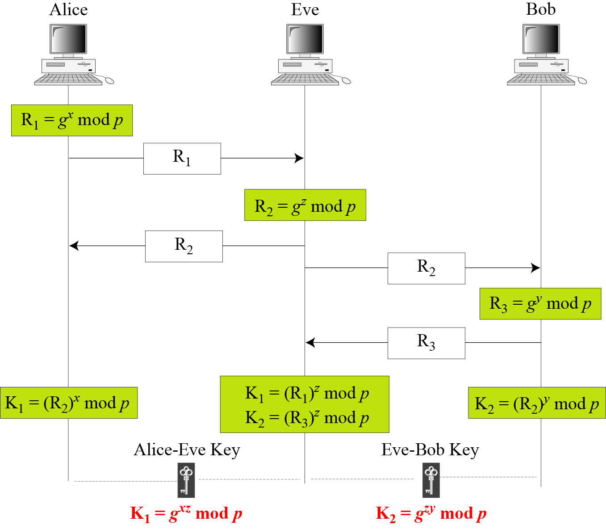
Man-in-the-middle attack

Slide 83
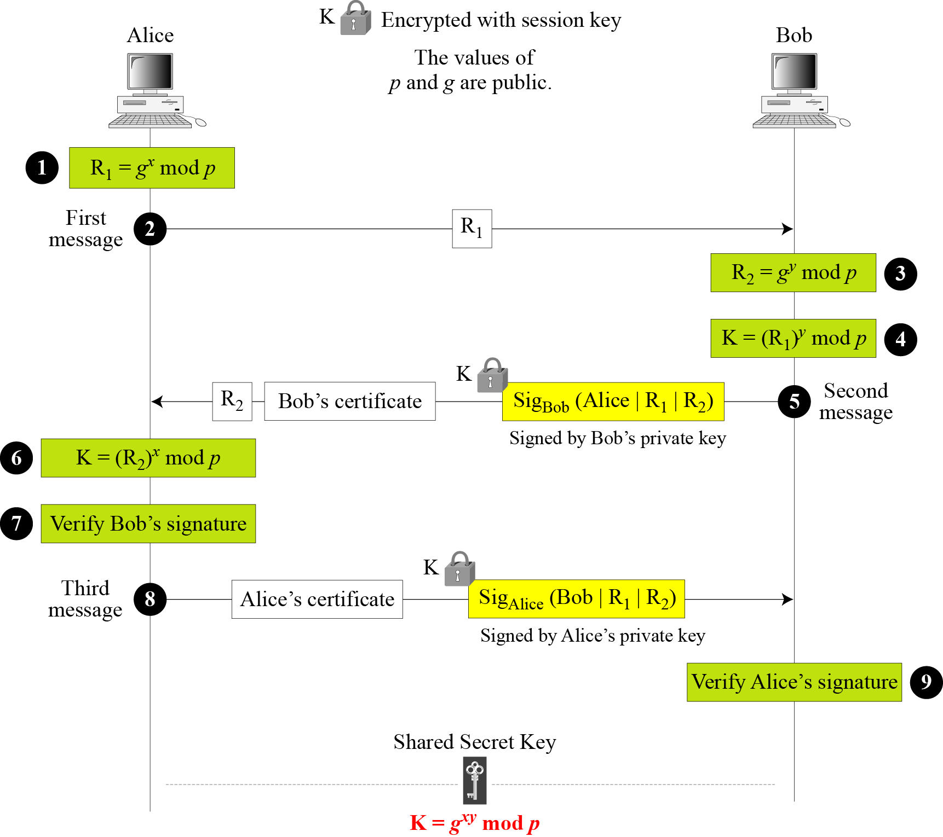
Figure Station-to-station key agreement method

Slide 84
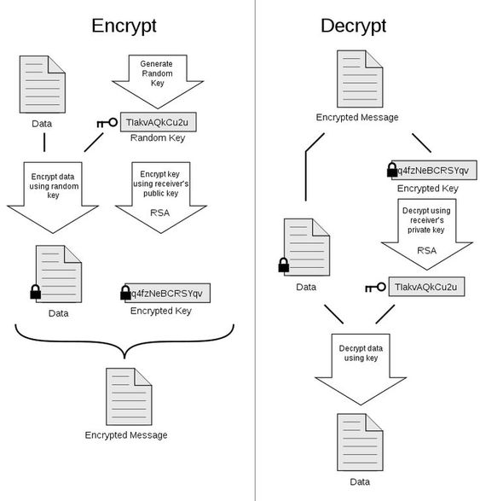
Certificates: Trustable Identities and Public Keys
A certificate is a public key and an identity bound together and signed by a certificate authority.
A certificate authority is an authority that users trust to accurately verify identities before generating certificates that bind those identities to keys.

Slide 85

15.4.3 Controlled Trusted Center
Controlled trusted center

Slide 86

15.4.4 Certification Authority
Figure Certification authority

Slide 87

Certificate Signing and Hierarchy
HTTPS helps greatly in reducing the information leaked to third parties. However, it does not prevent tracking. Modern browser fingerprinting techniques work even behind HTTPS. Security researchers have developed a browser extension called HTTPS Everywhere that attempts to use HTTPS whenever possible and at the same time mitigate the use of fingerprinting techniques.
Diana’s certificate is made using Edward’s signature. Delwyn’s certificate includes Diana’s certificate so that it can effectively be tied back to Edward, creating a chain of trust.

Slide 88

One-Way Hash Function
Digital Signature

Slide 89

Cryptographic Tool Summary

Slide 90

Digital Signature

Slide 91

Digital Signature- Hash Function

Slide 92

What happens with URLs?

Slide 93
Summary
Encryption helps prevent attackers from revealing, modifying, or fabricating messages
Symmetric and asymmetric encryption have complementary strengths and weaknesses
Certificates bind identities to digital signatures

